Slide 1

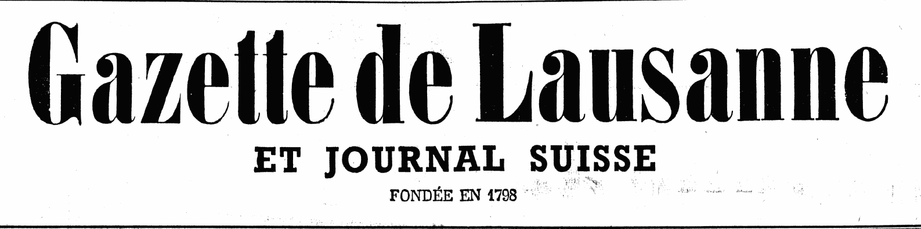
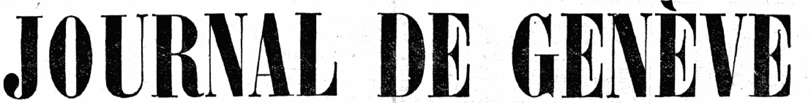
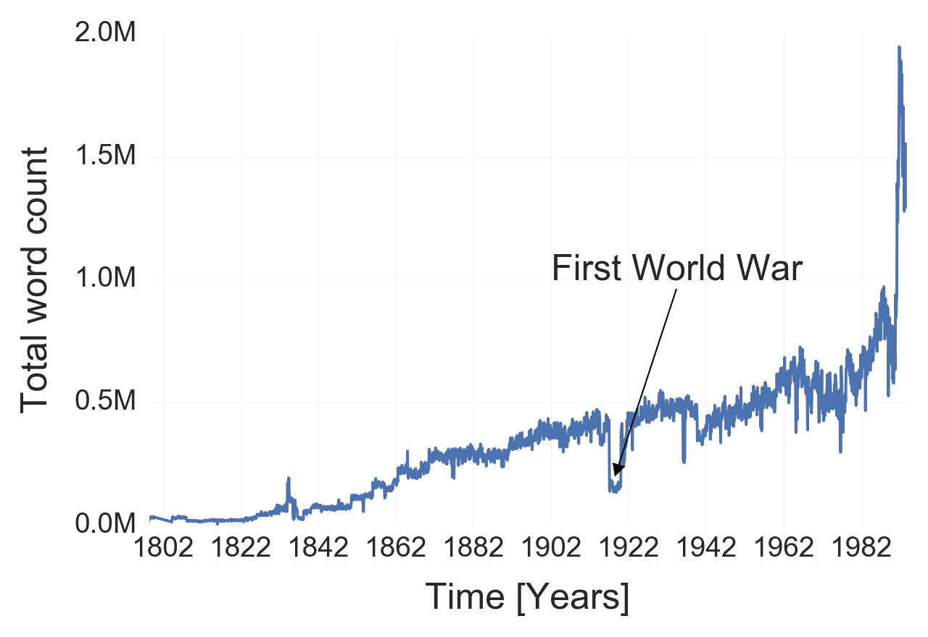
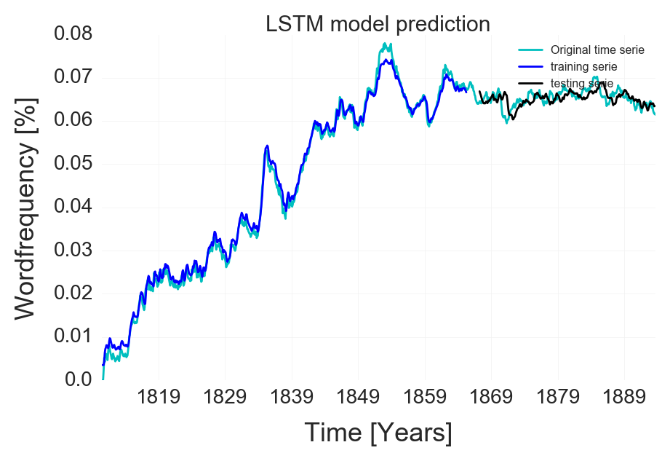
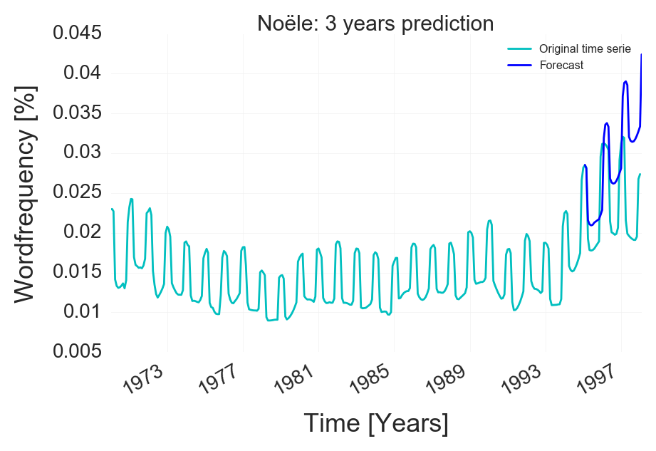
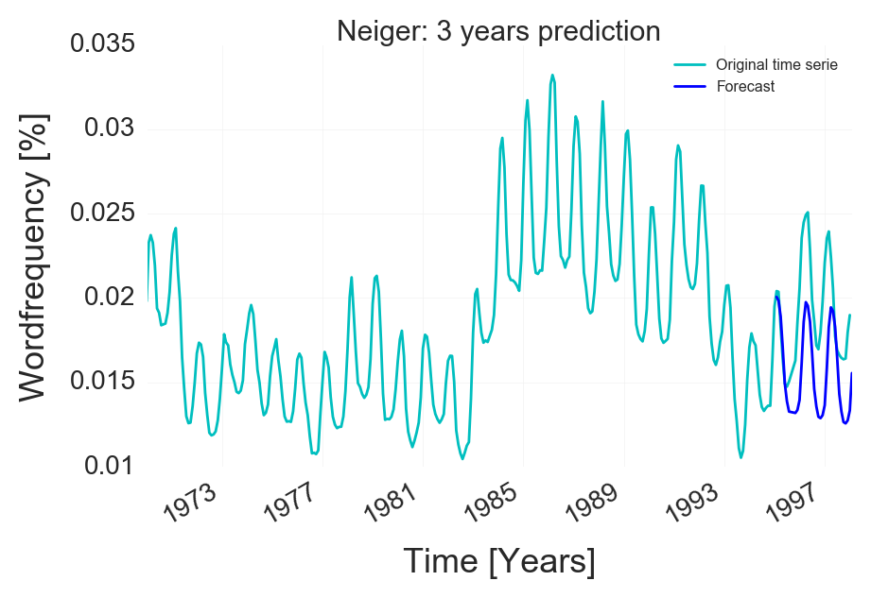
Applied Data Analysis – Le Temps Dataset Word Frequency Prediction
The Dataset:
200 years of daily articles from:
Publication dates: 1798 – 1998
Publication dates: 1826 – 1998
Extraction: Counting the 3000+ most frequent words per month
Data Extraction:
Removal of punctuation
Removal of French stop words
Custom NLTK processing:
Singular / Plural
Masculin / Féminin
Verbs and their conjugations
Adverbs + Noun
Removal of words that were not present enough
Result: Time serie of the frequency of each word
LSTM model prediction:
A simple LSTM (long short term memory) was used for predicting the time serie. The serie decaled so that previous time value were given as input to the model that must predict the future time value. This is a regression model with RNN (recurent neural network).
Result: The model is not making true forecast, it has simply learn to output the previous time value with some minor change. In oder words it mimick the time serie. It make sense as the model is trying to reduce the error and the previous time value are not to far away from the future time value.
SARIMA model prediction for seasonal words:
A SARIMA (Seasonal autoregressive integraded moving average) model was used for predicting the time serie.
This model use a combination of autoregression with moving average component plus seasonal component in order to output forecast.
Result: The model is able to predict the correct seasonality of the words and output a coherent trend with the last data of the time serie. But it is not able to integrate local changing trend which can be seen as random and thus it output a repetitive prediction that always goes in the same direction. Thus, while the prediction can be good for a short horizon, the reliability of the prediction decreases as we try to predict further.

